Slide 1
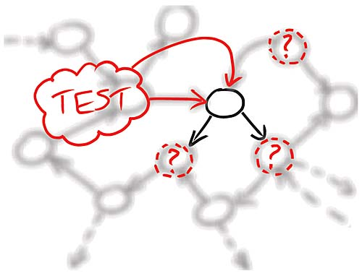




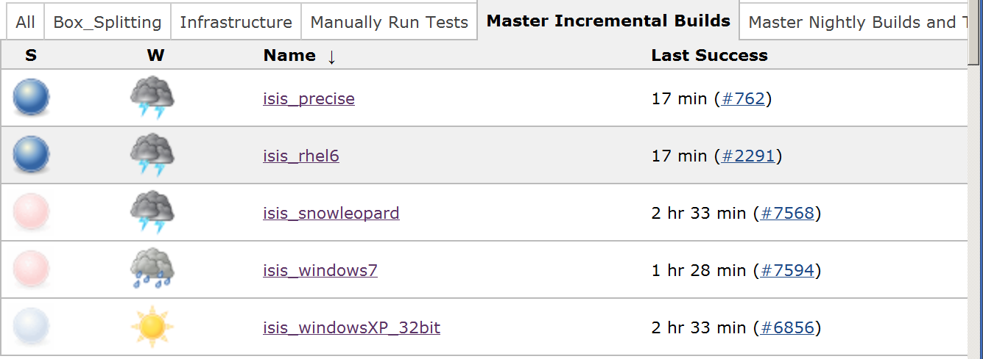





Continuous Build, Test and Deployment – the Mantid Model
Owen Arnold
Tessella, 26 The Quadrant, Abindon Science Park, Abingdon, Oxfordshire, OX14 3YS
Backlog
Development
Testing
Release
End User and Scientist Requests
Scientific Steering Comittee
Write a failing test
Make the test pass
Refactor
RHEL6
Slave
Incremental Job
Clean Job (queued)
Windows 7 Slave
Clean (feature branch) Job
Ubuntu Slave
Performance Test Job
CppCheck Job
Acknowledgements

